Slide 1
Linear Regression – Part 1
Nina Gunnes
October 22, 2020

Slide 2
Fit of a straight line
Several medical examples of monotonic relations
High cholesterol increasing risk of heart disease
High blood pressure increasing risk of heart disease
People with high blood pressure also having high cholesterol?
Some people at a particular high risk of heart disease
Suggesting a common underlying cause of heart disease
Using regression analysis to describe relation between two measures
Capturing the tendency in a scatter plot by adding a straight line

Slide 3
Example: Height and shoe size
Sex | Female | Female | Male | Female | Female | Female | Female | Female | Female | Female | Male | Male
Height | 158 | 167 | 180 | 165 | 158 | 167 | 175 | 162 | 165 | 159 | 182 | 187
Shoe size | 36 | 39 | 42.5 | 40 | 38 | 38 | 38 | 36.5 | 38.5 | 37 | 44 | 43
Sex | Male | Female | Male | Male | Female | Male | Female | Female | Female | Female | Male | Female
Height | 177 | 179.5 | 180 | 180 | 185 | 182 | 178 | 185 | 176 | 163.5 | 178 | 168
Shoe size | 41.5 | 40.5 | 44 | 45 | 41 | 42 | 42 | 41 | 40 | 37 | 42 | 38
Sex | Female | Male | Female | Male | Male | Male | Female | Female | Female | Female | Female | Female
Height | 165 | 174 | 173 | 190 | 189 | 180 | 168 | 182 | 167 | 155 | 168 | 172
Shoe size | 37 | 42 | 38 | 45.5 | 45 | 45 | 37 | 42 | 38 | 36.5 | 39.5 | 39

Slide 4
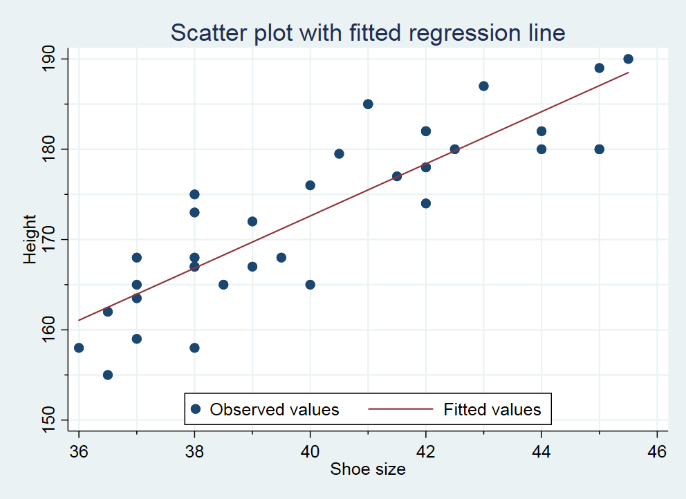
Example: Height and shoe size, cont.

Slide 5
Example: Height and shoe size, cont.
Taller people tending to have larger shoe sizes
Not a deterministic relation between height and shoe size
Just a (strong) tendency
Dots in scatter plot not generally falling on the line – just close to it

Slide 6
Fit of a straight line, cont.
Where to put the line in the scatter plot?
An objective criterion
Must be as close as possible to all of the dots
Need a measure of how far from the line the dots are
Considering the vertical distance from each point to the line
Distances squared and added together $⟹$ sum of squares
Choosing the so-called least-squares line
Line that minimizes the sum of squares

Slide 7
Fit of a straight line, cont.

Slide 8
Fit of a straight line, cont.
General formula for a straight line: $y=a+bx$
$a$: intercept (i.e., point where the line intersects with the y-axis)
$b$: slope
Which values of $a$ and $b$ give the best fit?
Assuming data on $n$ subjects represented by dots in a scatter plot
$\left(x_{1}, y_{1}\right), \left(x_{2}, y_{2}\right), …, \left(x_{n}, y_{n}\right)$
Defining the sum of squares (to be minimized)
$\sum_{i=1}^{n}{{\left(y_{i}−\left[a+bx_{i}\right]\right)}^{2}}=\sum_{i=1}^{n}{{\left(y_{i}−a−bx_{i}\right)}^{2}}$

Slide 9
Fit of a straight line, cont.
Defining the sample standard deviations and sample covariance
$s_{x}=\sqrt{\frac{1}{n−1}\sum_{i=1}^{n}{{\left(x_{i}−\overline{x}\right)}^{2}}}$ and $s_{y}=\sqrt{\frac{1}{n−1}\sum_{i=1}^{n}{{\left(y_{i}−\overline{y}\right)}^{2}}}$
$s_{xy}=\frac{1}{n−1}\sum_{i=1}^{n}{\left(x_{i}−\overline{x}\right)\left(y_{i}−\overline{y}\right)}$
Solving the least-squares problem by differentiation
$\hat{b}={s_{xy}}/{s_{x}^{2}}$
$\hat{a}=\overline{y}−\hat{b}\overline{x}$
$⟹$ Line $y=\hat{a}+\hat{b}x$ corresponding to the minimum sum of squares

Slide 10
Example: Height and shoe size, cont.
$$\hat{a}$$
$$\hat{b}$$

Slide 11
Example: Height and shoe size, cont.
Predicted height of subject with shoe size 39:
$$57.12+2.89×39≈170$$

Slide 12
Fit of a straight line, cont.
Defining the residual sum of squares
$\text{RSS}=\sum_{i=1}^{n}{{\left(y_{i}−\hat{a}−\hat{b}x_{i}\right)}^{2}}=\left(n−1\right)\left(s_{y}^{2}−\hat{b}s_{xy}\right)$
The residual (i.e., error) we are left with when applying the best-fit line
Defining the standard error of the regression
$\text{SER}=\sqrt{{\text{RSS}}/{\left(n−2\right)}}$
Measure of the variation in the dots along the best-fit line
Called “Root MSE” in the Stata output
Using the SER to create confidence intervals for predicted values

Slide 13
Example: Height and shoe size, cont.

Slide 14
Fit of a straight line, cont.
Defining a confidence interval for the slope of the best-fit line
$\hat{b}±c\frac{SER}{\sqrt{\left(n−1\right)s_{x}^{2}}}$
$c$: quantile of the Student’s t distribution with $n−2$ degrees of freedom
Calculations rarely (never?) performed by hand
Using statistical software such as R, Stata, and SPSS

Slide 15
Example: Height and shoe size, cont.
0.975 (2.5%) quantile of the Student’s t distribution with 34 degrees of freedom:
$$c=2.032245$$

Slide 16
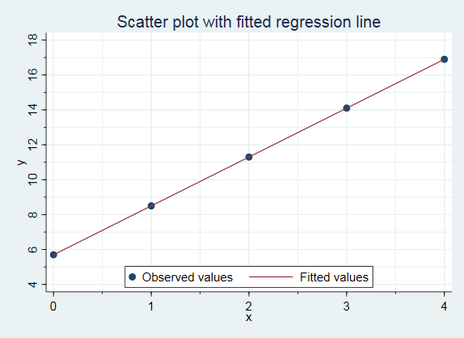
Example: Deterministic relation

Slide 17
Example: Deterministic relation, cont.

Slide 18
Correlation
How close are the dots in a scatter plot to the straight line?
Perfect linear relation between two variables $⟹$ all dots on the line
Data usually scattered around
Pearson’s correlation coefficient: $r={s_{xy}}/{\left(s_{x}s_{y}\right)}$
Measure of how well the data are concentrated along a straight line
Always between -1 and 1, with 0 indicating no linear relation
Negative (positive) number indicating negative (positive) linear relation
Spearman’s correlation coefficient assessing monotonic relations

Slide 19
Example: Correlation of simulated data

Slide 20
References
Aalen OO, Frigessi A, Moger TA, Scheel I, Skovlund E, Veierød MB. 2006. Statistiske metoder i medisin og helsefag. Oslo: Gyldendal akademisk.

